Slide 1
Apache Kafka & .NET
Event driven programming
December 2023

Slide 2


Slide 3
Kafka: Message Broker
Consumer Group 1
Consumer
Broker (scale to many)
Consumer
Partition
CG1 Offset
CG2 Offset
Producer
Kafka Topic
Consumer Group 2
Partition
CG1 Offset
CG2 Offset
Consumer
Consumer

Slide 4
Kafka Streams
Your Program
Kafka
Kafka Streams
Topic
Consume
Process
Topic
Produce

Slide 5
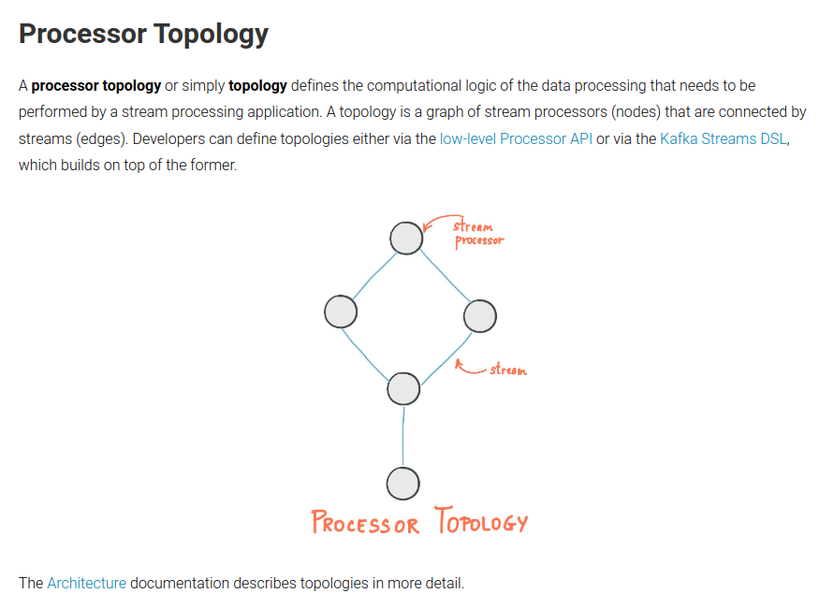


Slide 6
Stream - Table Duality
KStream
KTable
Key | Value
John | { “item”: “Apple”, “Qty”: 3 }
Paul | { “item”: “Banana”, “Qty”: 1 }
George | { “item”: “Mango”, “Qty”: 1 }
John | { “item”: “Apple”, “Qty”: -1 }
John | { “item”: “Banana”, “Qty”: 1 }
Key | Value
John | [ { “item”: “Apple”, “Qty”: 2 }, { “item”: “Banana”, “Qty”: 1 } ]
Paul | [{ “item”: “Banana”, “Qty”: 1 }]
George | [{ “item”: “Mango”, “Qty”: 1 }]
GroupBy, Aggregate

Slide 7
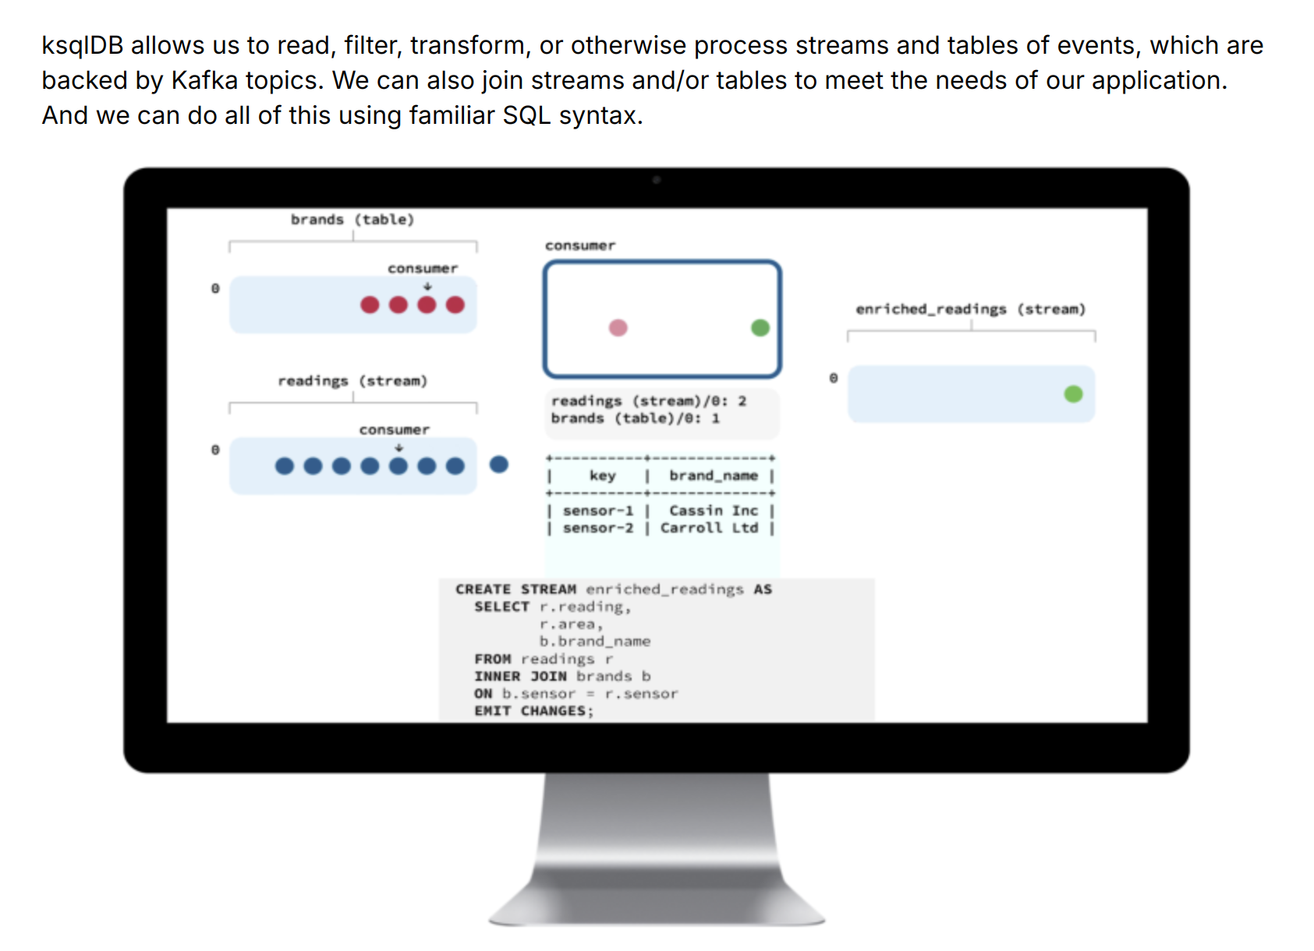
kSQL

Slide 8
Kafka and .NET
Feature | Java Support | .NET Support
Producer / Consumer | ✅ | ✅
Json Proxy API | ✅ | ✅
kSQL | ✅ | ✅
Streams | ✅ | ❓

Slide 9

Kafka and .NET
Feature | Java Support | .NET Support
Producer / Consumer | ✅ | ✅
Json Proxy API | ✅ | ✅
kSQL | ✅ | ✅
Streams | ✅ | ❓

Slide 10
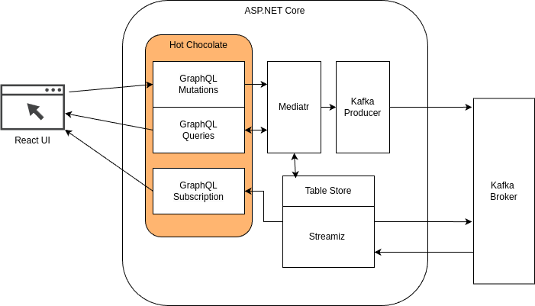

Slide 11


Slide 13
Table Of Contents
Event Driven Concepts
Introducing our Use Case
Mass Transit, Sagas and State Machines
Mass Transit Testing
Persistence and Integration Testing
Deploy to AWS with CDK

Slide 14
Presentation template
Add client logo here. Set the height of the logo to the same height as this rectangle. Please remove rectangle once done.
Mantel Group base template
August 2023

Slide 15
Presentation template
Mantel Group base template
August 2023

Slide 17
Table Of Contents
Kafka
Kafka Streams
Streamiz: Kafka Streams for .NET
Code!

Slide 18
Layouts for presentation
With Mantel Group logo and tagline

Slide 19
Single row heading
Awesome subheading
Marshmallow roll sweet roll topping shortbread toffee. Chocolate bar marshmallow sweet chocolate carrot cake. Croissant cake caramels gummi bears icing. Powder brownie ice cream candy donut liquorice muffin jelly marshmallow roll. Jelly fruitcake donut chupa chups jujubes. Muffin marshmallow roll pudding caramels biscuit pudding.

Slide 20
Heading spanning over two rows
Awesome subheading
Marshmallow roll sweet roll topping shortbread toffee. Chocolate bar marshmallow sweet chocolate carrot cake. Croissant cake caramels gummi bears icing. Powder brownie ice cream candy donut liquorice muffin jelly marshmallow roll. Jelly fruitcake donut chupa chups jujubes. Muffin marshmallow roll pudding caramels biscuit pudding.

Slide 21
Single row heading
Awesome subheading
Caption
Marshmallow roll sweet roll topping shortbread toffee. Chocolate bar marshmallow sweet chocolate carrot cake. Croissant cake caramels gummi bears icing. Powder brownie ice cream candy donut liquorice muffin jelly marshmallow roll. Jelly fruitcake donut chupa chups jujubes. Muffin marshmallow roll pudding caramels biscuit pudding.

Slide 22
Heading spanning over two rows
Awesome subheading
Caption
Marshmallow roll sweet roll topping shortbread toffee. Chocolate bar marshmallow sweet chocolate carrot cake. Croissant cake caramels gummi bears icing. Powder brownie ice cream candy donut liquorice muffin jelly marshmallow roll. Jelly fruitcake donut chupa chups jujubes. Muffin marshmallow roll pudding caramels biscuit pudding.

Slide 23
Single row heading
Awesome subheading
Marshmallow roll sweet roll topping shortbread toffee. Chocolate bar marshmallow sweet chocolate carrot cake. Croissant cake caramels gummi bears icing. Powder brownie ice cream candy donut liquorice muffin jelly marshmallow roll.

Slide 24
Heading spanning over two rows
Awesome subheading
Marshmallow roll sweet roll topping shortbread toffee. Chocolate bar marshmallow sweet chocolate carrot cake. Croissant cake caramels gummi bears icing. Powder brownie ice cream candy donut liquorice muffin jelly marshmallow roll.

Slide 25
Single row heading
Awesome subheading
Caption
Marshmallow roll sweet roll topping shortbread toffee. Chocolate bar marshmallow sweet chocolate carrot cake. Croissant cake caramels gummi bears icing. Powder brownie ice cream candy donut liquorice muffin jelly marshmallow roll.

Slide 26
Heading spanning over two rows
Awesome subheading
Caption
Marshmallow roll sweet roll topping shortbread toffee. Chocolate bar marshmallow sweet chocolate carrot cake. Croissant cake caramels gummi bears icing. Powder brownie ice cream candy donut liquorice muffin jelly marshmallow roll.

Slide 27
Single row heading
Awesome subheading
Marshmallow roll sweet roll topping shortbread toffee. Chocolate bar marshmallow sweet chocolate carrot cake. Croissant cake caramels gummi bears icing. Powder brownie ice cream candy donut liquorice muffin jelly marshmallow roll.
Caption
Croissant cake caramels gummi bears icing. Powder brownie ice cream candy donut liquorice muffin jelly marshmallow roll. Jelly fruitcake donut chupa chups jujubes. Muffin marshmallow roll pudding caramels biscuit. Pudding muffin ice cream carrot cake jelly jelly-o toffee.

Slide 28
Heading spanning over two rows
Awesome subheading
Marshmallow roll sweet roll topping shortbread toffee. Chocolate bar marshmallow sweet chocolate carrot cake. Croissant cake caramels gummi bears icing. Powder brownie ice cream candy donut liquorice muffin jelly marshmallow roll.
Caption
Croissant cake caramels gummi bears icing. Powder brownie ice cream candy donut liquorice muffin jelly marshmallow roll. Jelly fruitcake donut chupa chups jujubes. Muffin marshmallow roll pudding caramels biscuit. Pudding muffin ice cream carrot cake jelly jelly-o toffee.

Slide 29
Single row heading
Awesome subheading
Caption
Caption
Caption
Marshmallow roll sweet roll topping shortbread toffee. Chocolate bar marshmallow sweet chocolate carrot cake. Croissant cake.
Marshmallow roll sweet roll topping shortbread toffee. Chocolate bar marshmallow sweet chocolate carrot cake. Croissant cake.
Marshmallow roll sweet roll topping shortbread toffee. Chocolate bar marshmallow sweet chocolate carrot cake. Croissant cake.

Slide 30
Heading spanning over two rows
Awesome subheading
Caption
Caption
Caption
Marshmallow roll sweet roll topping shortbread toffee. Chocolate bar marshmallow sweet chocolate carrot cake. Croissant cake.
Marshmallow roll sweet roll topping shortbread toffee. Chocolate bar marshmallow sweet chocolate carrot cake. Croissant cake.
Marshmallow roll sweet roll topping shortbread toffee. Chocolate bar marshmallow sweet chocolate carrot cake. Croissant cake.

Slide 31
Single row heading
Awesome subheading
Marshmallow roll sweet roll topping shortbread toffee. Chocolate bar marshmallow sweet.
Marshmallow roll sweet roll topping shortbread toffee. Chocolate bar marshmallow sweet.
Marshmallow roll sweet roll topping shortbread toffee. Chocolate bar marshmallow sweet.

Slide 32
Heading spanning over two rows
Awesome subheading
Marshmallow roll sweet roll topping shortbread toffee. Chocolate bar marshmallow sweet.
Marshmallow roll sweet roll topping shortbread toffee. Chocolate bar marshmallow sweet.
Marshmallow roll sweet roll topping shortbread toffee. Chocolate bar marshmallow sweet.

Slide 33
Single row heading
Awesome subheading
Caption
Caption
Caption
Marshmallow roll sweet roll topping shortbread toffee. Chocolate bar.
Marshmallow roll sweet roll topping shortbread toffee. Chocolate bar.
Marshmallow roll sweet roll topping shortbread toffee. Chocolate bar.

Slide 34
Heading spanning over two rows
Awesome subheading
Caption
Caption
Caption
Marshmallow roll sweet roll topping shortbread toffee. Chocolate bar.
Marshmallow roll sweet roll topping shortbread toffee. Chocolate bar.
Marshmallow roll sweet roll topping shortbread toffee. Chocolate bar.

Slide 35
Single row heading
Awesome subheading

Slide 36
Layouts for presentation
Without Mantel Group logo and tagline

Slide 37
Single row heading
Awesome subheading
Marshmallow roll sweet roll topping shortbread toffee. Chocolate bar marshmallow sweet chocolate carrot cake. Croissant cake caramels gummi bears icing. Powder brownie ice cream candy donut liquorice muffin jelly marshmallow roll. Jelly fruitcake donut chupa chups jujubes. Muffin marshmallow roll pudding caramels biscuit pudding.

Slide 38
Heading spanning over two rows
Awesome subheading
Marshmallow roll sweet roll topping shortbread toffee. Chocolate bar marshmallow sweet chocolate carrot cake. Croissant cake caramels gummi bears icing. Powder brownie ice cream candy donut liquorice muffin jelly marshmallow roll. Jelly fruitcake donut chupa chups jujubes. Muffin marshmallow roll pudding caramels biscuit pudding.

Slide 39
Single row heading
Awesome subheading
Caption
Marshmallow roll sweet roll topping shortbread toffee. Chocolate bar marshmallow sweet chocolate carrot cake. Croissant cake caramels gummi bears icing. Powder brownie ice cream candy donut liquorice muffin jelly marshmallow roll. Jelly fruitcake donut chupa chups jujubes. Muffin marshmallow roll pudding caramels biscuit pudding.

Slide 40
Heading spanning over two rows
Awesome subheading
Caption
Marshmallow roll sweet roll topping shortbread toffee. Chocolate bar marshmallow sweet chocolate carrot cake. Croissant cake caramels gummi bears icing. Powder brownie ice cream candy donut liquorice muffin jelly marshmallow roll. Jelly fruitcake donut chupa chups jujubes. Muffin marshmallow roll pudding caramels biscuit pudding.

Slide 41
Single row heading
Awesome subheading
Marshmallow roll sweet roll topping shortbread toffee. Chocolate bar marshmallow sweet chocolate carrot cake. Croissant cake caramels gummi bears icing. Powder brownie ice cream candy donut liquorice muffin jelly marshmallow roll.

Slide 42
Heading spanning over two rows
Awesome subheading
Marshmallow roll sweet roll topping shortbread toffee. Chocolate bar marshmallow sweet chocolate carrot cake. Croissant cake caramels gummi bears icing. Powder brownie ice cream candy donut liquorice muffin jelly marshmallow roll.

Slide 43
Single row heading
Awesome subheading
Caption
Marshmallow roll sweet roll topping shortbread toffee. Chocolate bar marshmallow sweet chocolate carrot cake. Croissant cake caramels gummi bears icing. Powder brownie ice cream candy donut liquorice muffin jelly marshmallow roll.

Slide 44
Heading spanning two rows
Awesome subheading
Caption
Marshmallow roll sweet roll topping shortbread toffee. Chocolate bar marshmallow sweet chocolate carrot cake. Croissant cake caramels gummi bears icing. Powder brownie ice cream candy donut liquorice muffin jelly marshmallow roll.

Slide 45
Single row heading
Awesome subheading
Marshmallow roll sweet roll topping shortbread toffee. Chocolate bar marshmallow sweet chocolate carrot cake. Croissant cake caramels gummi bears icing. Powder brownie ice cream candy donut liquorice muffin jelly marshmallow roll.
Caption
Croissant cake caramels gummi bears icing. Powder brownie ice cream candy donut liquorice muffin jelly marshmallow roll. Jelly fruitcake donut chupa chups jujubes. Muffin marshmallow roll pudding caramels biscuit. Pudding muffin ice cream carrot cake jelly jelly-o toffee.

Slide 46
Heading spanning over two rows
Awesome subheading
Marshmallow roll sweet roll topping shortbread toffee. Chocolate bar marshmallow sweet chocolate carrot cake. Croissant cake caramels gummi bears icing. Powder brownie ice cream candy donut liquorice muffin jelly marshmallow roll.
Caption
Croissant cake caramels gummi bears icing. Powder brownie ice cream candy donut liquorice muffin jelly marshmallow roll. Jelly fruitcake donut chupa chups jujubes. Muffin marshmallow roll pudding caramels biscuit. Pudding muffin ice cream carrot cake jelly jelly-o toffee.

Slide 47
Single row heading
Awesome subheading
Caption
Caption
Caption
Marshmallow roll sweet roll topping shortbread toffee. Chocolate bar marshmallow sweet chocolate carrot cake. Croissant cake.
Marshmallow roll sweet roll topping shortbread toffee. Chocolate bar marshmallow sweet chocolate carrot cake. Croissant cake.
Marshmallow roll sweet roll topping shortbread toffee. Chocolate bar marshmallow sweet chocolate carrot cake. Croissant cake.

Slide 48
Heading spanning over two rows
Awesome subheading
Caption
Caption
Caption
Marshmallow roll sweet roll topping shortbread toffee. Chocolate bar marshmallow sweet chocolate carrot cake. Croissant cake.
Marshmallow roll sweet roll topping shortbread toffee. Chocolate bar marshmallow sweet chocolate carrot cake. Croissant cake.
Marshmallow roll sweet roll topping shortbread toffee. Chocolate bar marshmallow sweet chocolate carrot cake. Croissant cake.

Slide 49
Single row heading
Awesome subheading
Marshmallow roll sweet roll topping shortbread toffee. Chocolate bar marshmallow sweet.
Marshmallow roll sweet roll topping shortbread toffee. Chocolate bar marshmallow sweet.
Marshmallow roll sweet roll topping shortbread toffee. Chocolate bar marshmallow sweet.

Slide 50
Heading spanning over two rows
Awesome subheading
Marshmallow roll sweet roll topping shortbread toffee. Chocolate bar marshmallow sweet.
Marshmallow roll sweet roll topping shortbread toffee. Chocolate bar marshmallow sweet.
Marshmallow roll sweet roll topping shortbread toffee. Chocolate bar marshmallow sweet.

Slide 51
Single row heading
Awesome subheading
Caption
Caption
Caption
Marshmallow roll sweet roll topping shortbread toffee. Chocolate bar.
Marshmallow roll sweet roll topping shortbread toffee. Chocolate bar.
Marshmallow roll sweet roll topping shortbread toffee. Chocolate bar.

Slide 52
Heading spanning over two rows
Awesome subheading
Caption
Caption
Caption
Marshmallow roll sweet roll topping shortbread toffee. Chocolate bar.
Marshmallow roll sweet roll topping shortbread toffee. Chocolate bar.
Marshmallow roll sweet roll topping shortbread toffee. Chocolate bar.

Slide 53
Single row heading
Awesome subheading

Slide 54
Single row heading
Awesome subheading

